Slide 1
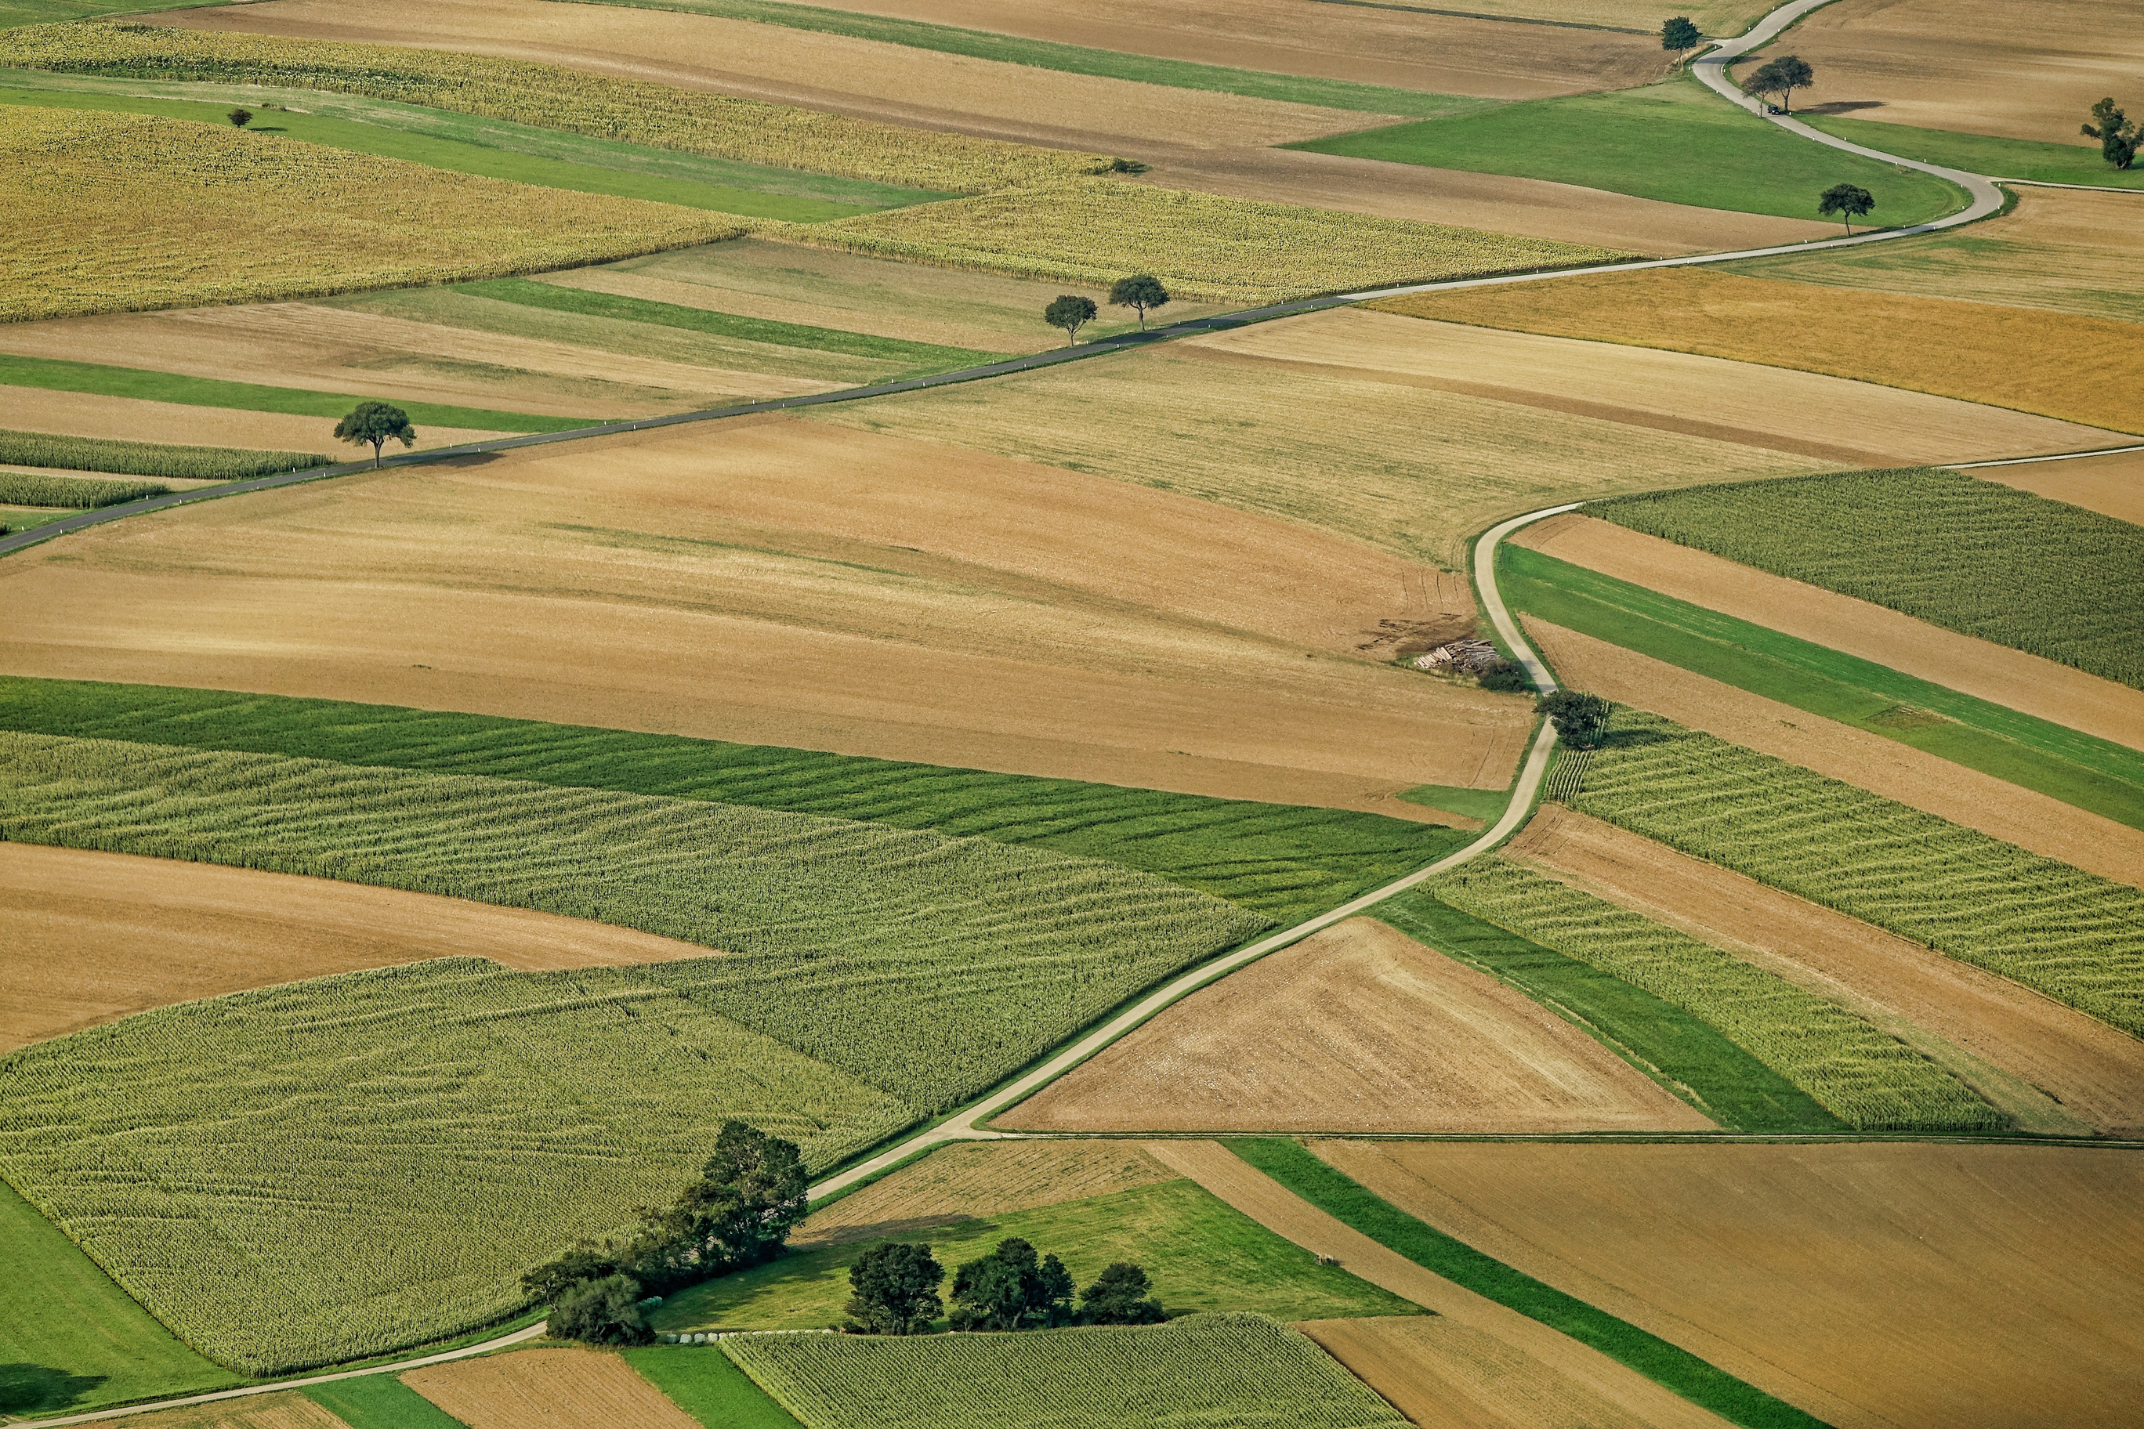

Paddy Cultivation
Effective management and Procurement in Telangana State
Presented by
Runtime Terror

Slide 2
The Problem
01
02
03
Procurement Delay
Persistence Issue
Lack of Facilities:
Farmers face significant delays (5-20 days) in selling their produce, causing financial stress.
Delays and costs have been ongoing problems for years, affecting livelihoods.
Many procurement centers lack essential infrastructure, storage, and sanitation facilities.

Slide 3
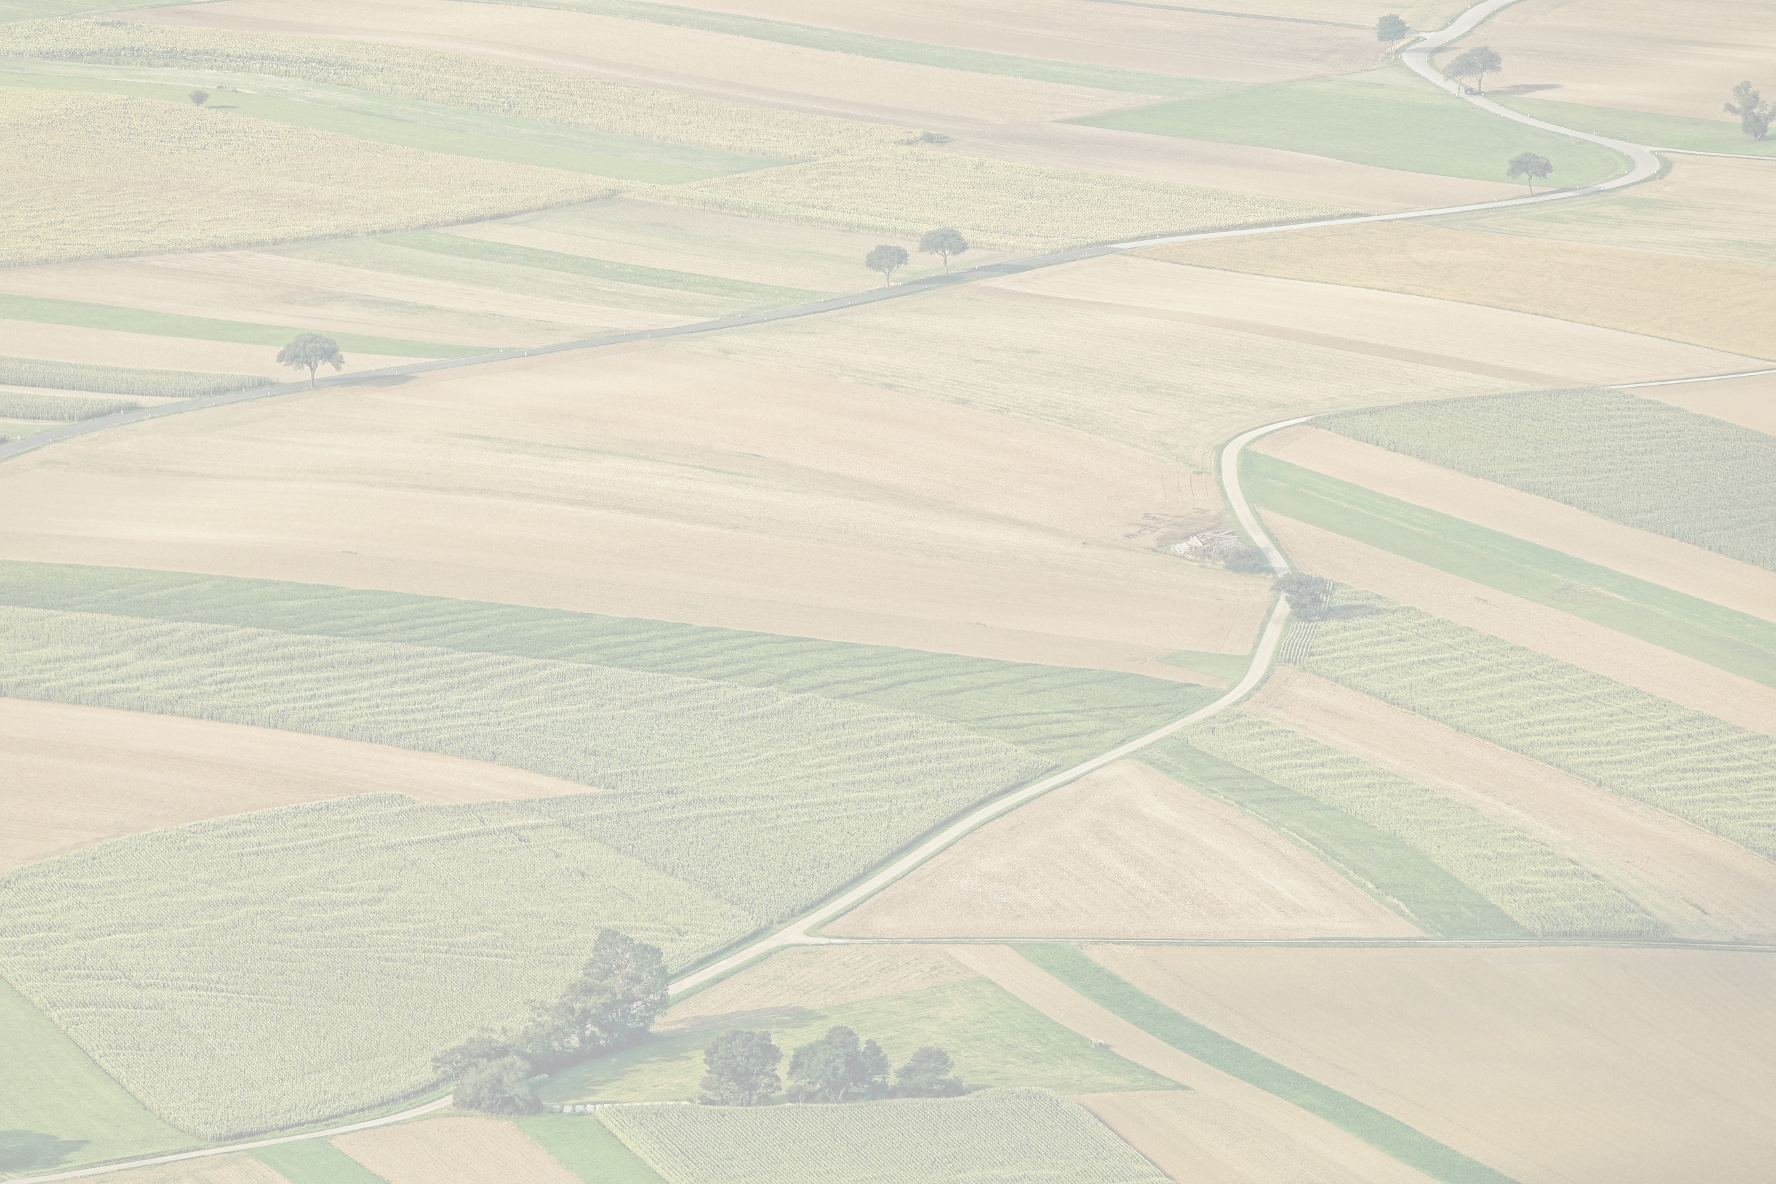

Issues to be tackled
01
02
03
04
Paddy Cultivation Identification:
Determining whether paddy is cultivated or not in a given area and identifying the type of paddy being cultivated.
Stages of Paddy Growth:
Monitoring the various stages of paddy growth, from sowing to harvesting.
Online Procurement System Integration:
Assessing the feasibility of issuing tokens to farmers within an Online Procurement System (OPMS) based on the successful harvest, with the objective of controlling external paddy sales in Telangana State.
Identification of Fake Paddy:
Developing methods to identify forged or substandard paddy to ensure the quality and authenticity of procured paddy

Slide 4

Our Approach
IMAGE
ATMOSPHERIC
PROCESSING
REFINED
IMAGE
IDENTIFYING
CROP
IS IT FAKE?
YES
IS IT PADDY?
NO
YES
NO
NO
IMAGE
PROCESSING
DETERMINING
HEALTHINESS
IDENTIFYING
STAGE
Notes:
insert a flowchart here.

Slide 5

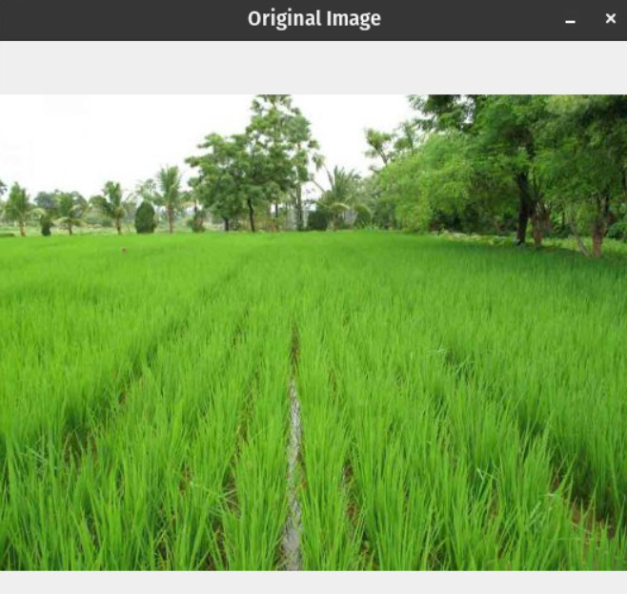
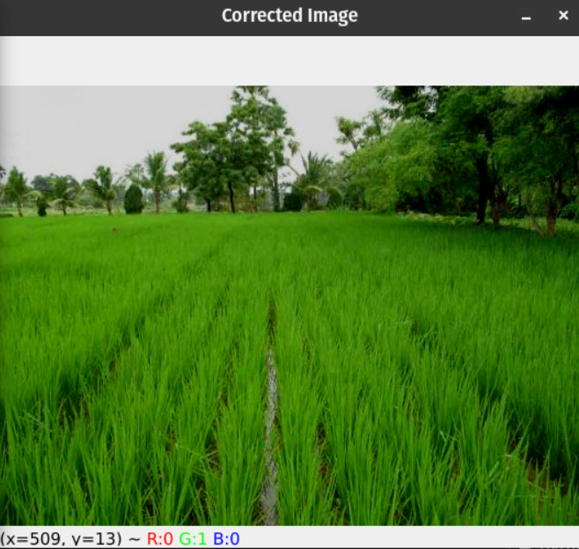
1. Atmospheric Processing
3 types of processing - atmospheric, geometric, and radioactive calibration.
Reducing noise to get more clarity in the image.
Atmospheric
Processing
*implemented atmospheric at the moment; can also implement geometric or radioactive calibration.
Notes:
insert a flowchart here.

Slide 6

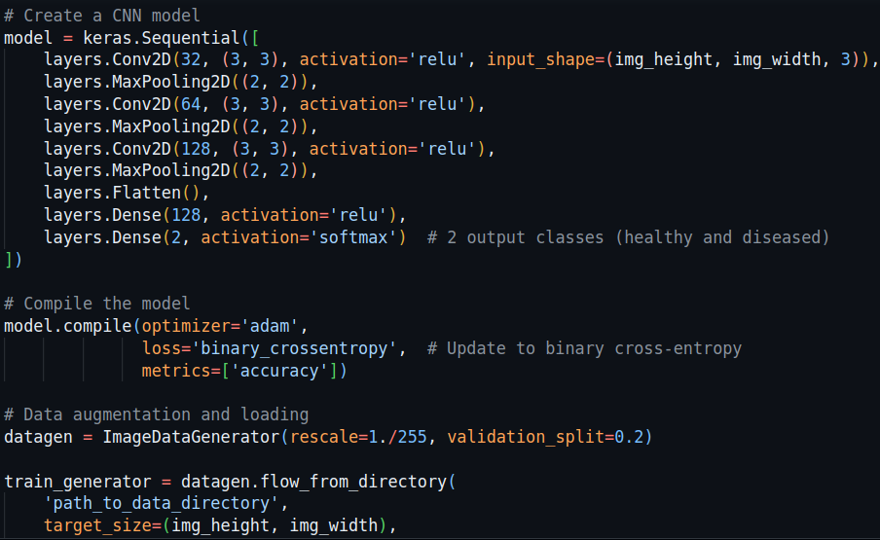
2. Crop Identification
Trained ML model to identify and distinguish between various types of crops including rice, wheat, etc. To the right is a code snippet for the same.
If the output is anything other than rice, then it is not considered.
As of now, the accuracy is 54%. With an even bigger data set, can train the model to have higher accuracy.
Notes:
insert a flowchart here.

Slide 7
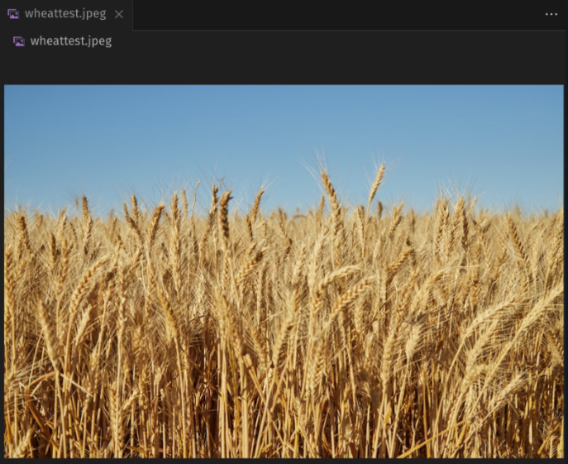
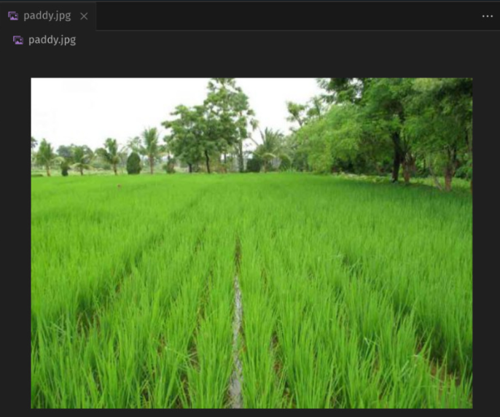
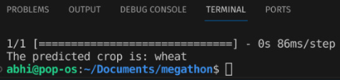
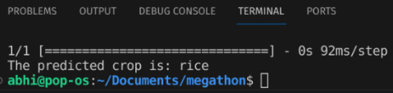
2. Crop Identification
Notes:
insert a flowchart here.

Slide 8
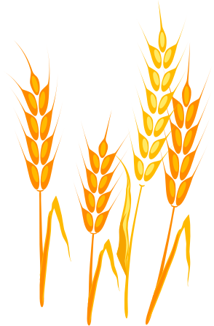
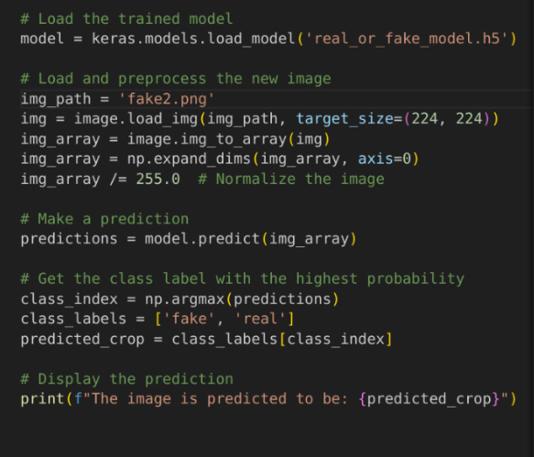
3. Identifying Fake Paddy
Identifying whether the given paddy is substandard.
Since a dataset for substandard paddy was not available, we used AI-generated images. To the right is the code snippet of the same.
If the output is ‘fake’, then the image is not considered for further analysis and hence, is discarded.
Accuracy is 88%.
Notes:
insert a flowchart here.

Slide 9
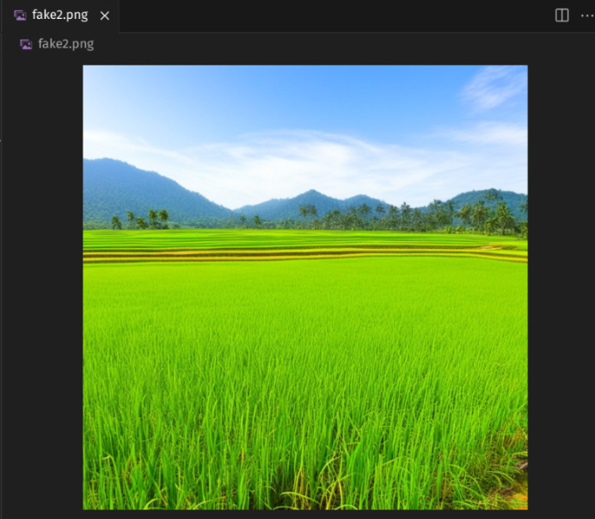
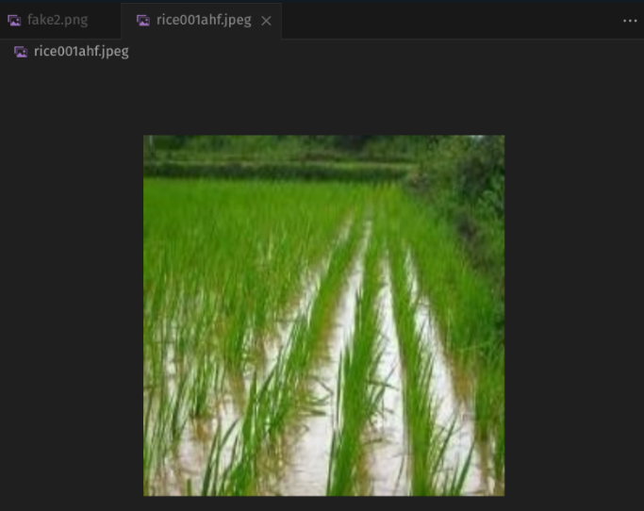
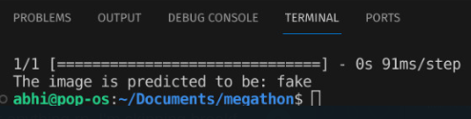
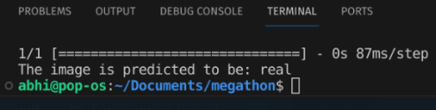
3. Identifying Fake Paddy
Notes:
insert a flowchart here.

Slide 10

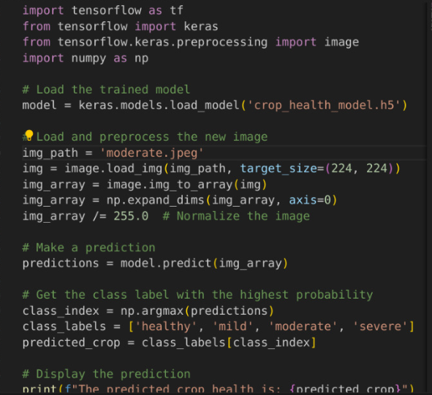
3. Determining healthiness
Classifying the crop into one of the 4 categories - healthy, mild, moderate, and severe. Code snippet to the right.
Trained model with a dataset sourced from Kaggle. (https://www.kaggle.com/datasets/girishkleit/riceonfiledimages)
Outputs the healthiness of the crop given in the image.
Accuracy is 74%.
Notes:
insert a flowchart here.

Slide 11
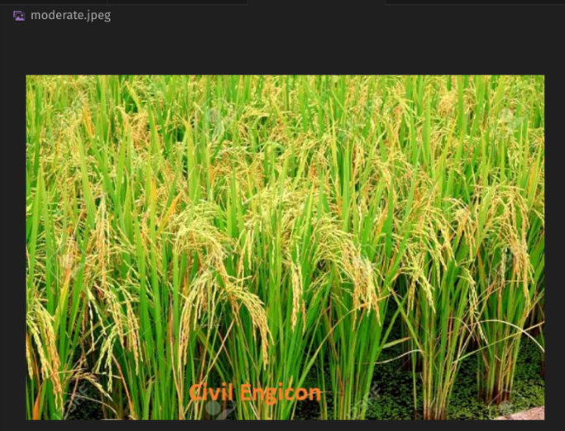
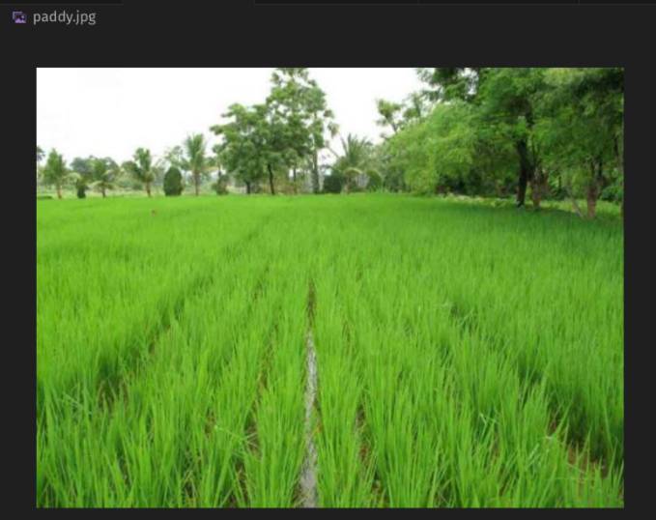
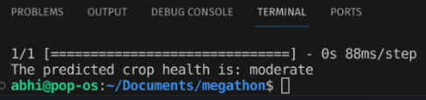
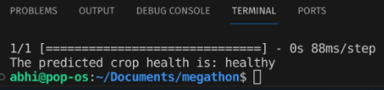
3. Determining healthiness
Notes:
insert a flowchart here.

Slide 12

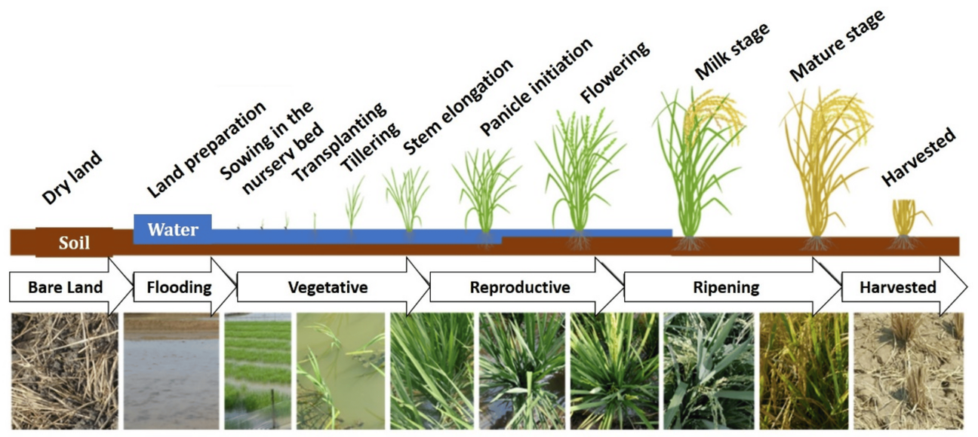
4. Identifying paddy growth stage
Using image processing techniques to identify which stage the paddy is currently in.
Used the MATLAB to determine if the paddy is young, grown, or ready to harvest.
Outputs dark green for grown crop, yellow for ready to harvest, and light green for young crop.
Notes:
insert a flowchart here.

Slide 13
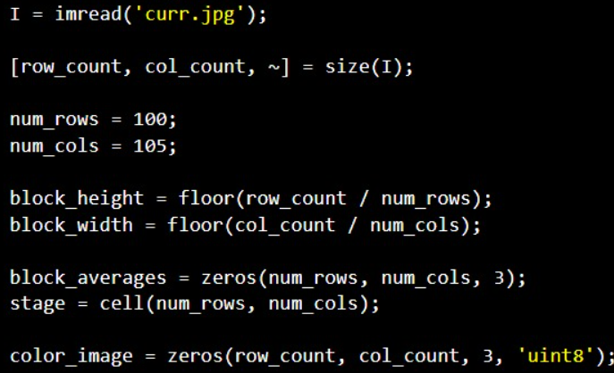
4. Identifying paddy growth stage
Algorithm:
1) Loading the image matrix, i.e. the RGB value of each pixel is loaded into I which is a 3D matrix.
2) Getting the dimensions of the given image, i.e. Rows*Columns
3) Splitting the entire image into multiple smaller images in order to analyse particular blocks of fields, instead of analysing the entire image (group of paddy fields).
4) Initializing the output matrices
Notes:
insert a flowchart here.

Slide 14
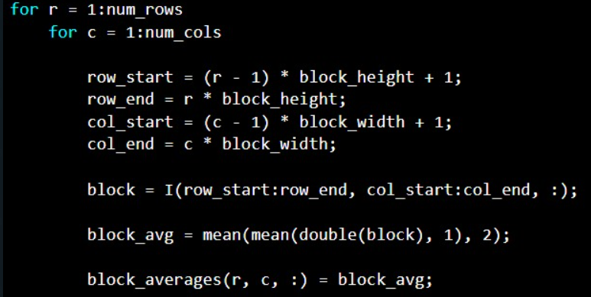
4. Identifying paddy growth stage
Calculating the average of Red, Green and blue color components in the given block of smaller image in to get an idea of the stage of crop
Notes:
insert a flowchart here.

Slide 15
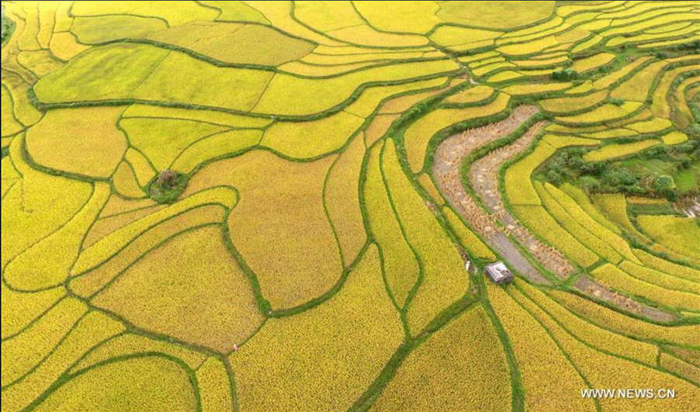
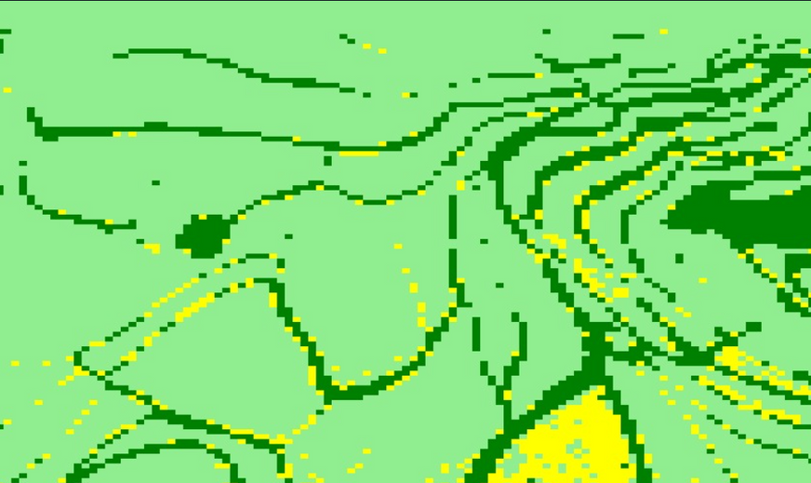
4. Identifying paddy growth stage
Image
Processing
Light green areas indicate the presence of young and burgeoning crops.
Dark green regions represent fully grown crops.
The yellow segments signify crops at the optimal harvest stage.
Brown patches delineate either harvested fields or areas prepared for sowing.
Notes:
insert a flowchart here.

Slide 16
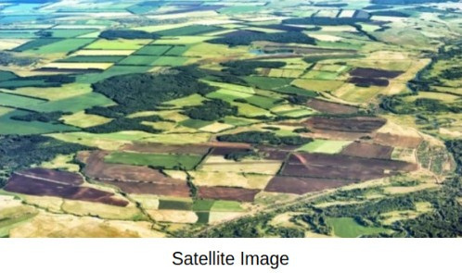
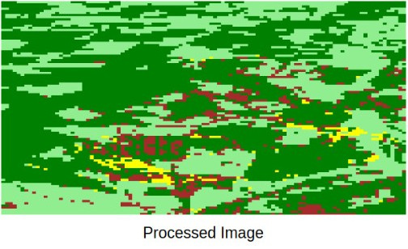
4. Identifying paddy growth stage
Image
Processing
Light green areas indicate the presence of young and burgeoning crops.
Dark green regions represent fully grown crops.
The yellow segments signify crops at the optimal harvest stage.
Brown patches delineate either harvested fields or areas prepared for sowing.
Notes:
insert a flowchart here.

Slide 17
4. Identifying paddy growth stage
Using image processing techniques to identify which stage the paddy is currently in.
Used the Normalised Difference Vegetation Index (NDVI) value to determine if the paddy is sowing, growing, or ready to harvest stage.
NDVI values for different stages were observed to be:
barren/sowing: -0.10 to -0.04
growing: 0.20 to 0.36
ready to harvest: -0.02 to 0.06
Notes:
insert a flowchart here.

Slide 18
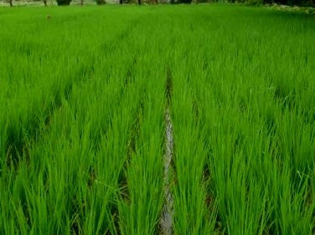
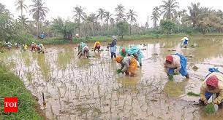
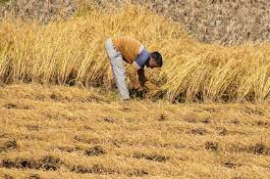
4. Identifying paddy growth stage
Notes:
insert a flowchart here.

Slide 19

5. Online Procurement System (OPMS)
An Online Procurement System (OPMS) is a digital platform for purchasing agricultural produce, like paddy, directly from farmers at a predetermined price.
"Tokens" are certificates verifying a farmer's eligibility to sell harvested paddy through the OPMS, typically issued upon a successful harvest.
Successful harvest indicates when paddy is ready for sale and meets quality standards, triggering the issuance of tokens.
The aim is to regulate paddy sales by issuing tokens only to genuine harvesters, ensuring control and monitoring through the OPMS, and preventing unauthorized open market sales.
Notes:
insert a flowchart here.

Slide 20
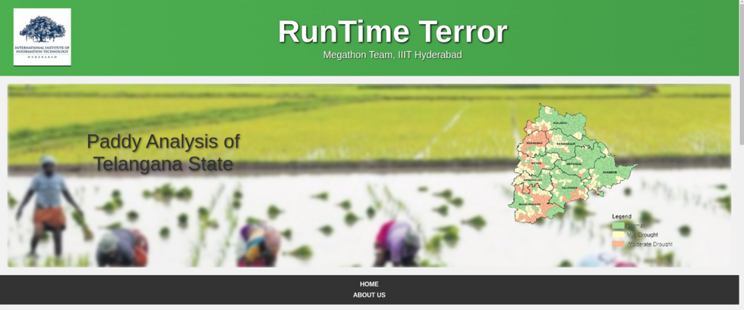
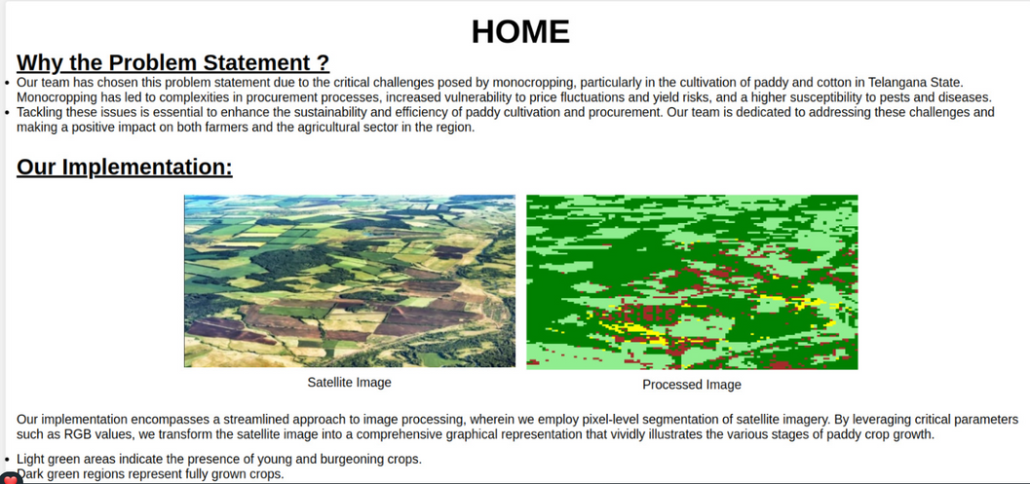
5. Online Procurement System (OPMS)
Made for the government and the market, in order to ensure an efficient service for farmers without facing significant delays.
Farmers can register online. With the help of image processing and ML models, we can predict the total crop and further set the price for the farmer accordingly.
Can also predict productivity based on the sensor data provided by farmers.
Notes:
tentative time required for harvest.

Slide 21
Further Optimizations
Populate the dataset with more number of images to increase the accuracy of the model.
Populate the dataset of AI-generated images with actual images of substandard paddy, so as to get the right result.
Suggest methods safety measures and suggestions for improving the health of the crop
Predict income based on the health of the crop, taking the previous year’s data into consideration.
Predict the time required for the crop to mature and be harvested based on the images given (using image processing and ML).

Slide 22

Codebase
https://github.com/Abhinav7R/Megathon

Slide 23


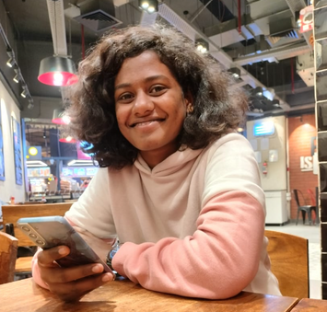



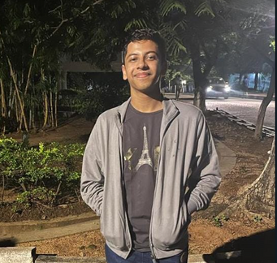
Our Team
Runtime Terror
D SREE
YASHASWINEE
ABHINAV RAUNDHAL
GARGIE TAMBE
YASH
SHINDE
YASH BHUTADA

Slide 24

THANK YOU

